Slide 1

GRAPHICA! 2025 TITLE PAGE
#PROBLEM STATEMENT: AIT Pune Nexus – Unifying the campus experience
#THEME: Digital Fragmentation
#PS CATEGORY: Software
#TEAM NAME: Loop

Slide 2

IDEA TITLE
Logic System & Role Based Access: The portfolio acts as a living document of a student’s academic journey, capturing interdisciplinary learning.
Data Collection: Collects data through the user input to manage resources, academic performance, and digital campus development effectively.
Innovation Display: Tracks innovation through hackathons, entrepreneurship cells, industry collaborations, and student-led projects showcased via portfolio.
Data-Visualization: Usage of various templates to display one’s portfolio for better understanding.

Slide 3
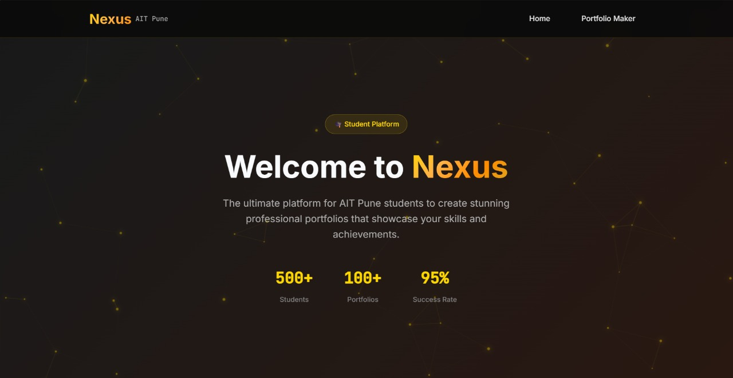
User Interface
Navigation Bar
Home
Portfolio
Introduction
Information

Slide 4
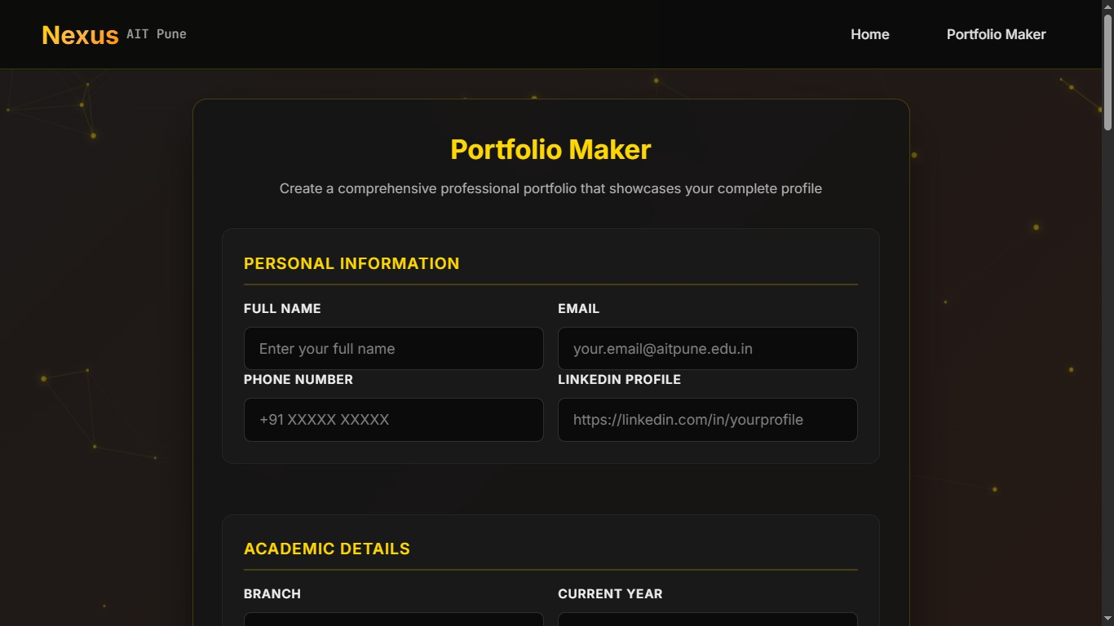
Portfolio Interface
Portfolio User Interface
Personal Information

Slide 5
RESEARCH AND REFERENCES
Market and user Research:
#Competetive Analysis:- Systematically study existing portfolio (e.g., Nexus, Adobe Portfolio, etc.).
#Target Audience Analysis:- Go beyond demographics. Create user personas for idea customer .
Product and Feature Research:
#USP (Unique Selling Proposition):- Based on your market research, brainstorm what will make your website unique.

